Slide 1
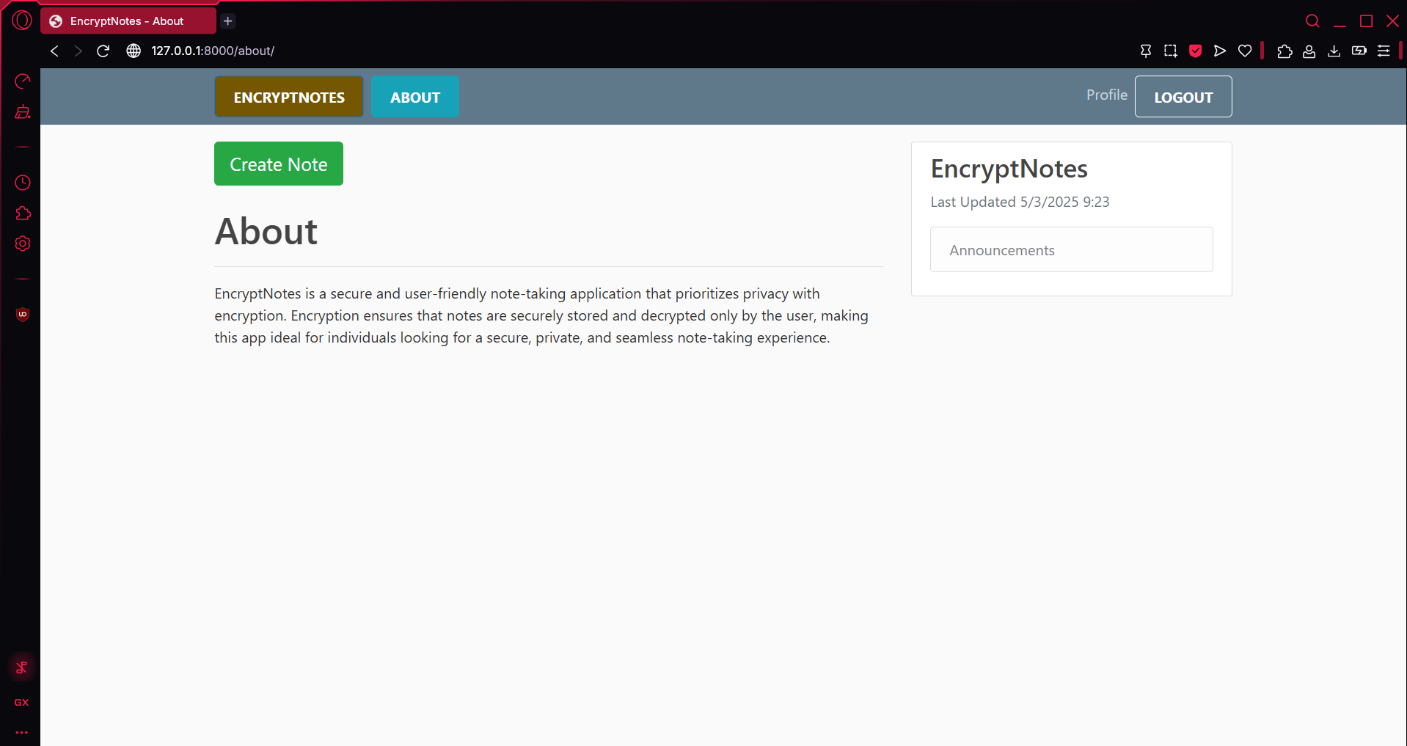
EnCryptNotes Secure and Intelligent Note Management
CPT-200 Team 2 - Phase 4

Slide 2

What is it?
Secure, AI-powered Note App
Accessed from Web Browser
Privacy & Efficiency Top priorities

Slide 3

Why EncryptNotes?
Easily accessible
No downloads
Unlike Other apps –
Ours doesn’t Lack of security
Ours doesn’t have Poor organization
Ours has automatic categorization

Slide 4
Key Features
End to End Encryption
AI-Powered Categorization
User-Controlled Security Setting
Note Editing and Management
User Account Controls

Slide 5
Technical Overview
Application
Powered by Python and Django
User Authentication
Secure authentication with Django
Encryption
Data encrypted before saving to database
Decrypted upon access from database
MySQL Database

Slide 6
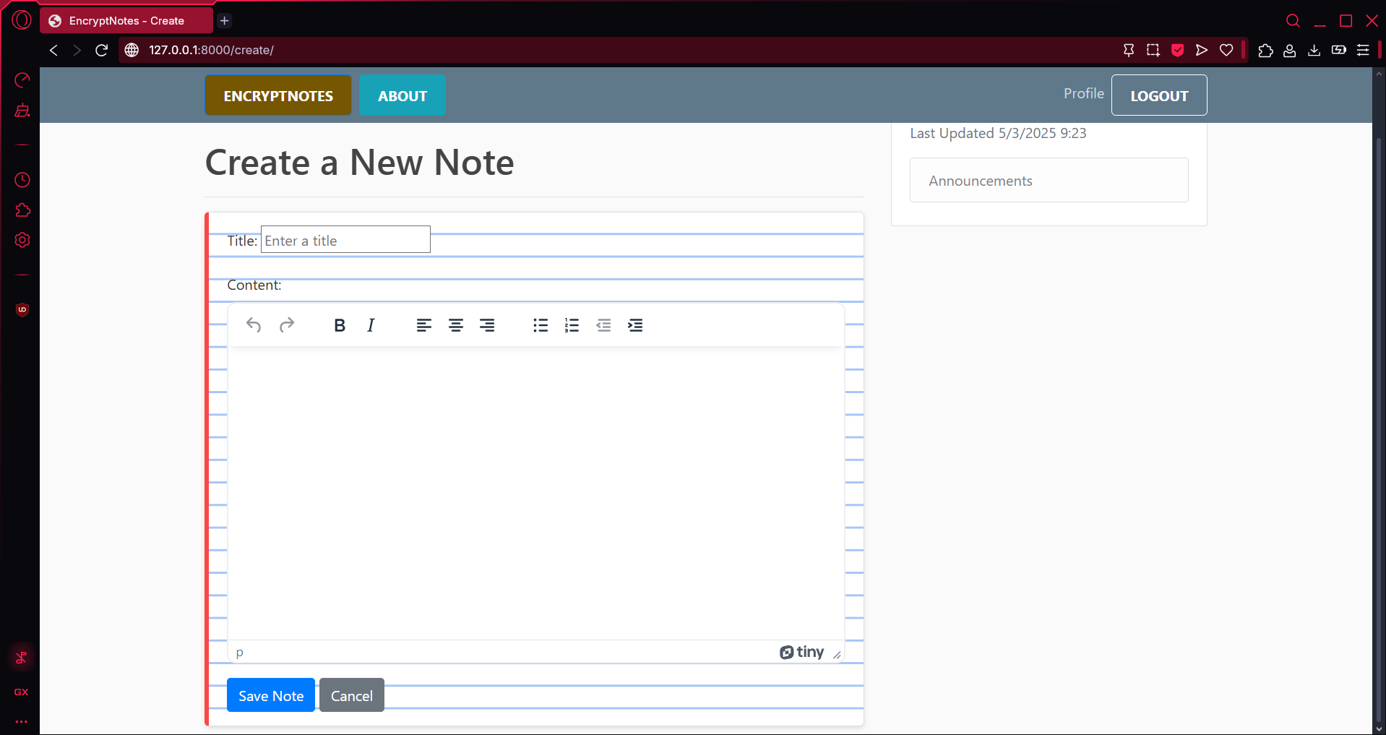
Unique Features
Powerful TinyMCE Editor utilized to create, edit, and view
AI powered note categorization with Google AI

Slide 7
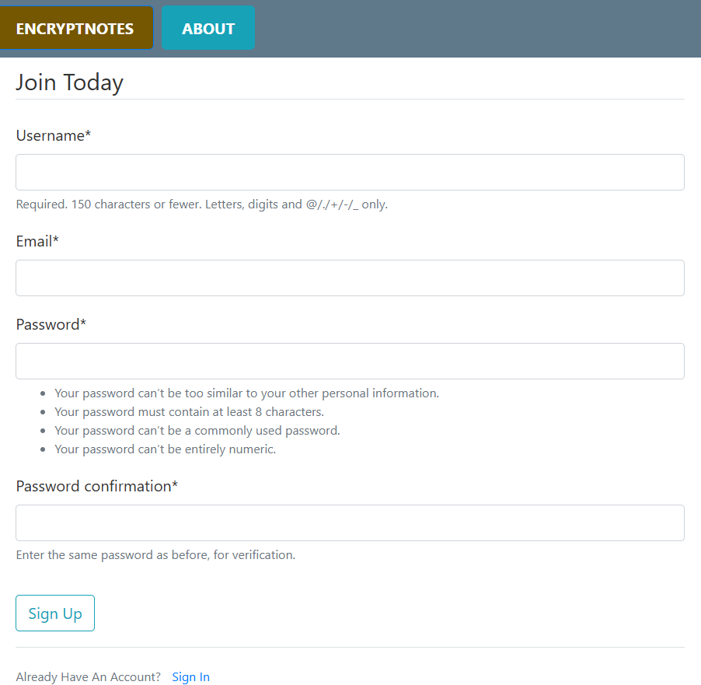
Sign Up Page
Minimum password requirements for enhanced security

Slide 8

Who would use it?
Students – Secure College Notes
Business Professionals – Secure Work Notes
Other Privacy Focused Individual Users

Slide 9
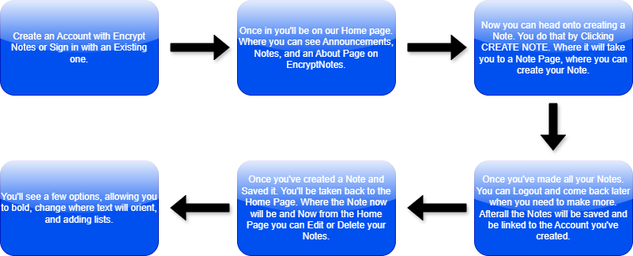
So How Do You Use It?

Slide 10
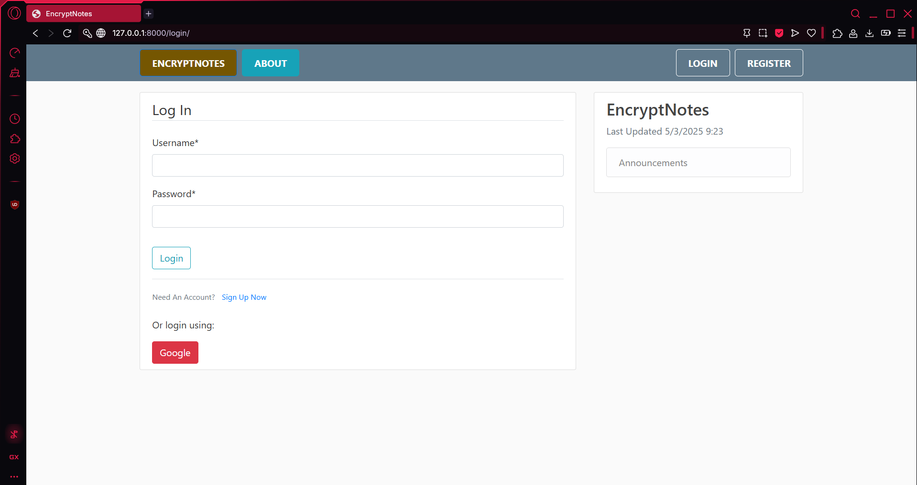
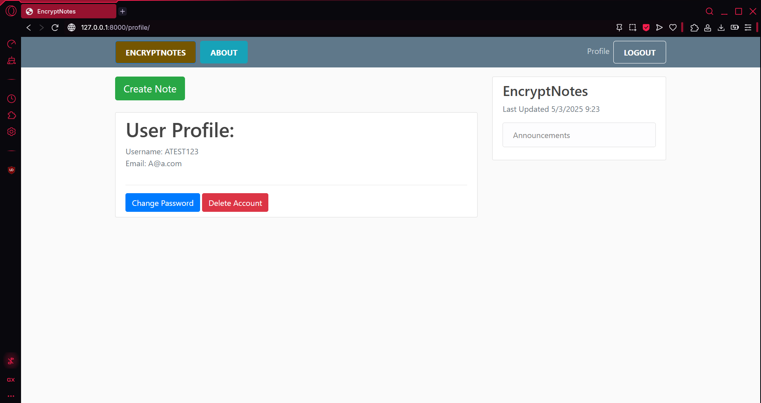
Login/profile page
Here is an Image of the second step.
This is showing the Login page and User page once Logged in.

Slide 11
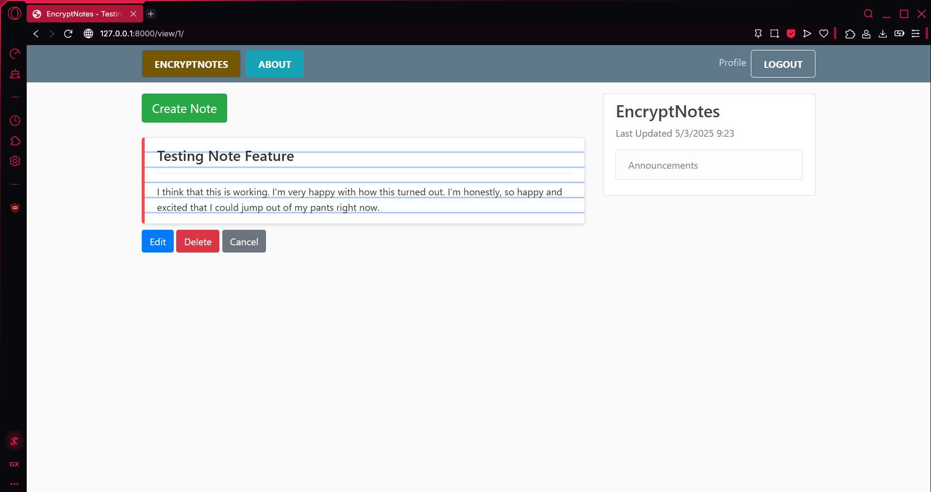
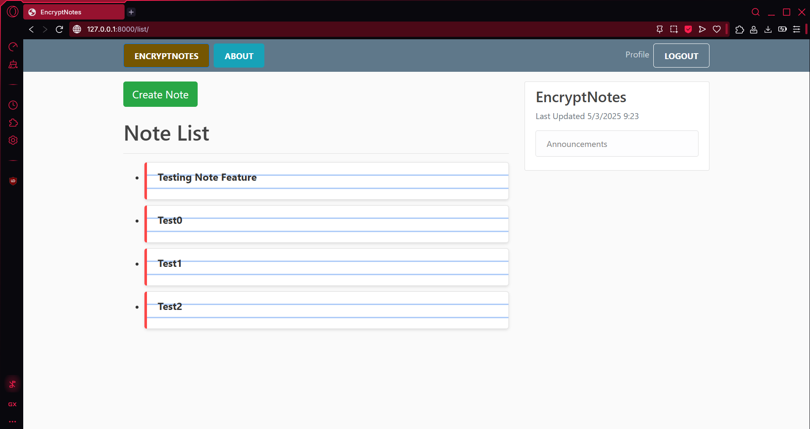
Note Pages

Slide 12
Demo

Slide 13

Questions?

